Slide 1
Graduate Records
Darci L. Rollins
Records Coordinator since 2010.

Slide 2
Graduate Students 2010 - 2019

Slide 3
Paperless petitions and forms
Over 16 credit hour limit.
Individual exception to committee policy.
Committee petition online (new online 2018).
Time Limit exceptions.
Non-matriculated credits (new form 2018).
Language Verifications forms and documentation.
Manuscript Submission forms (new 2018).
Applying for graduation, the first time is on CIS.

Slide 4
Apply Yourself Tracking bachelor& master degrees.
Tracking students who are admitted to the bachelor & master combined program of Interest.
Notifying the department by email with the new requirement; having the bachelor & master credit petition submitted by their 1st matriculated semester.
Updating information on the petition page.
Graduation Office entered in bachelor & master approved coursework in students’ online files under the petition tab.

Slide 5
Dual and Concurrent Degrees
Tracking Dual and Concurrent Degrees.
Requesting from department a list of all students who have elected to do a Dual or Concurrent Degree.
Enter this identifying information into the students’ online files.

Slide 6
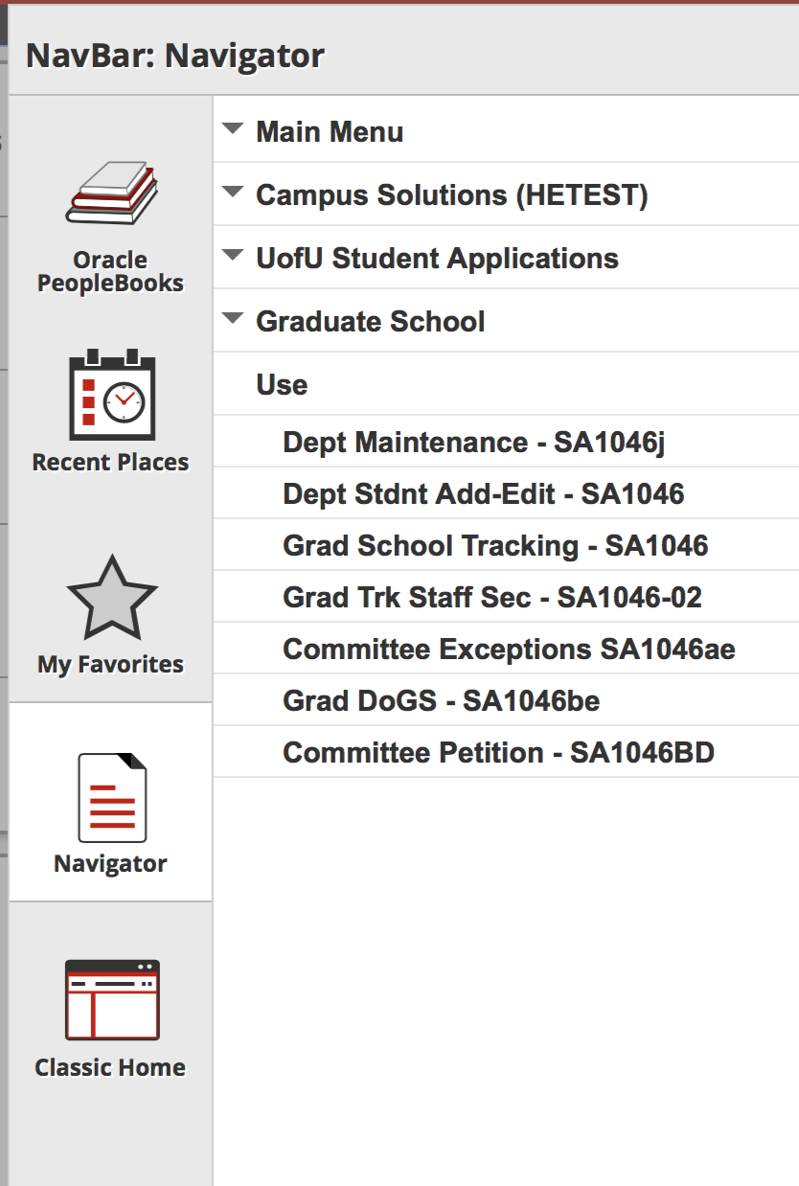
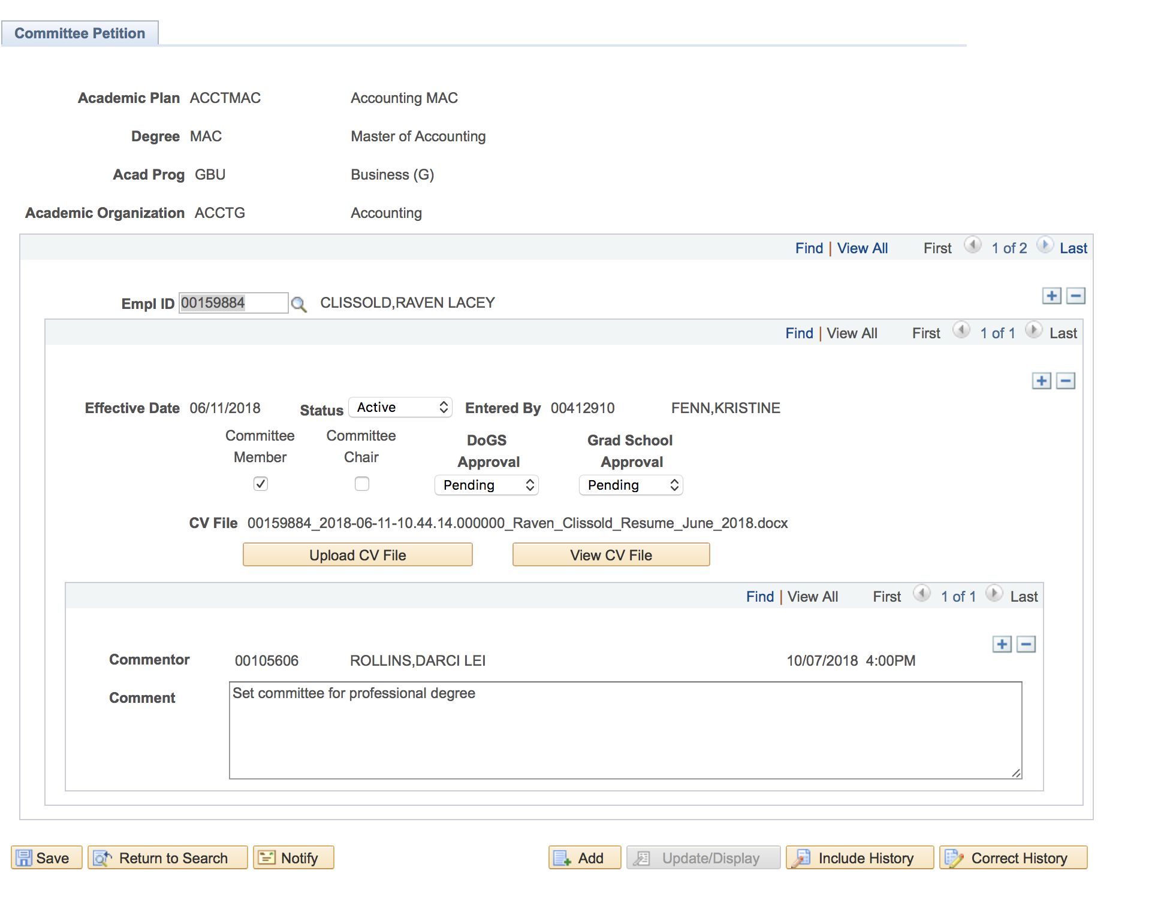
Updates in the Graduate Tracking System 2018 Committee Petitions & Faculty Committee Report.
Continued

Slide 7
Updates 2018
Updated graduated student report to show totals of students.
Updated policy for BS/MS petitions with Registrar’s Office.
Changed name of committee petition from Blanket to Committee.
Blanket Committees.
Core Committees.
Set Committees.
Continued

Slide 8
Graduate Student Summary All tabs in their online files are open to students for view.

Slide 9
Upcoming updates for 2019
Graduate Advisors comment tab.
Graduated student report for departments.
Committee petition audit report-show approvals.
Template for program of study.
Continue to look for opportunities to serve the graduate students, Graduate Advisors and Faculty.

