Slide 1
Program Reviews/
Associate Dean Initiatives

Slide 2
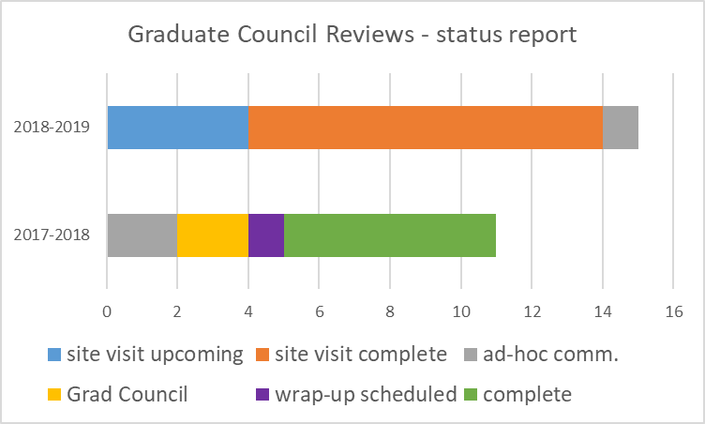
PROGRAM REVIEW UPDATE
Review timeline:
Visit scheduled
Visit complete
Ad-hoc
reporting
Grad Council
Wrap-up
scheduled
Complete!
Over 60 internal
and external
reviewers
*
*includes coordination of 7+
reviews for the Business School
MOU update responses
are in progress as well:
4/9 received from Fall requests
8 to be requested in Spring

Slide 3
FYI:
2019-20 REVIEWS (10)
Asian Studies
City & Metropolitan Planning
Clinical Investigation MS
English
Health, Kinesiology and Recreation
Neurobiology and Anatomy
Nursing
Pathology/Medical Laboratory Science
Pharmacotherapy
PharmD
Denise and I will meet
with chairs this Spring.

Slide 4
PROGRAM REVIEW ACCOMPLISHMENTS
26 high-quality reviews completed or on track to completion during last two years
Report compiling diversity topics from past reviews created
Program Review portal created and more extensive archiving system under development

Slide 5
PROGRAM REVIEW GOALS
Maintain high standards and continually ensure process is running smoothly
Finish development of archival systems, disseminate information on access, and keep these repositories up-to-date in timely fashion
Develop a procedures manual that documents work-flow of review process
Better track inclusion of Curriculum Management plans and 7-year Learning Outcome plans in self-studies; incorporate into MOUs and updates
Hold follow-up discussions on diversity and other common review issues

Slide 6
Other Initiatives
Workshops: worked with Danny to continue expanding offerings
Raised mental health as a priority theme, with workshops on stress management, resilience, etc
and by encouraging development of Stress Management for Graduate Students course. Also
(thanks to input from Jen M), distributing resource pamphlets at other events.
Shifted model for CTLE workshops, giving this series more focus and letting the experts design;
Would like to expand that model to Career & Professional Development Center, others
Added Graduate Student Resource Fair – an offering we can continue to offer and improve
Would like to add ‘Best Practice Forums’ for faculty

Slide 7
Other Initiatives
Web-site: worked with Danny to continue improving Grad School web-site
Adding resources, creating better navigation - ongoing!!
Thanks to Rick for help with videos!
Return to idea of creating on-line orientation materials

Slide 8
Other Initiatives
Serving as co-chair of Graduate Student Success Working Group within the
Educational Futures and Student Success Taskforce
> hoping that this is an opportunity to gather broad input on upcoming priorities
> have drafted Araceli onto the committee and will be getting input from the office in general

Slide 9
Master calendar – Danny
with general timelines posted in appropriate places on web-site
i.e., general times of year for funding workshops, thesis workshops etc
internally, this can be used for our own planning
Workshops
It has worked reasonably well to shift emphasis of CTLE collaboration:
they plan education/teaching base series – we help advertise
enhance other collaborations – work on same model for career services, counseling?
Hold Best Practice Forums
Budget notes
timeline of external reviewer honoraria increases
acknowledgement gifts for internal reviewers?
Stress Management course

