Slide 1

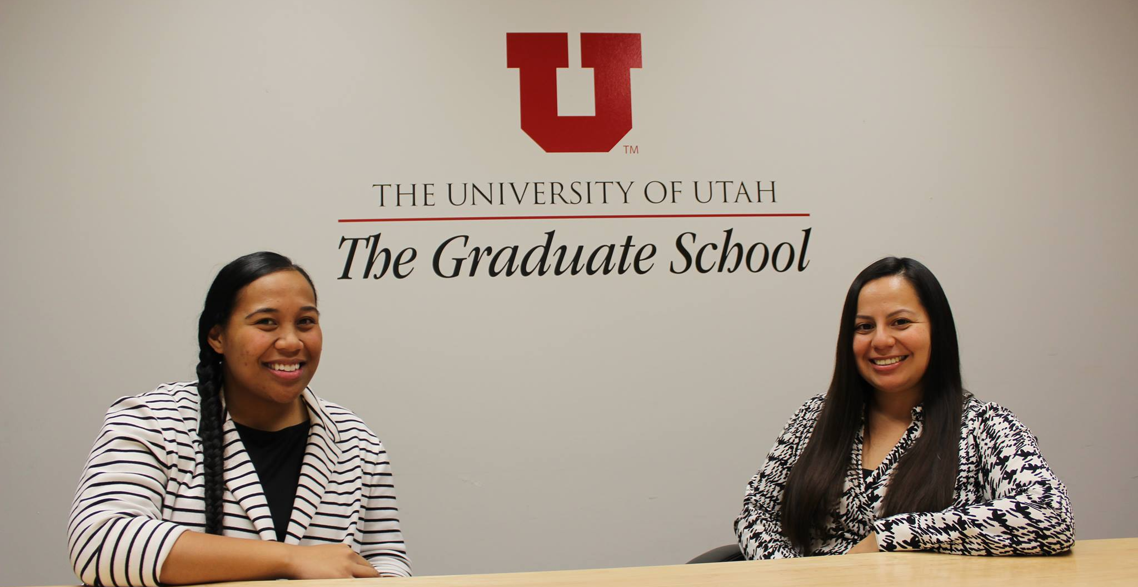
Graduate School Retreat
February 15, 2019

Slide 2
Achievements: 2018 - 2019
6th Annual Underrepresented Graduate Student Social
  N = 125
Graduate Diversity Council
Assistant Director search/hire
McNair Graduate Fellowships
McNair Scholars Graduate Network
Status update meetings w/Diversity Fellows
OED meetings with Deans regarding Diversity Action Plans (8 so far)
Improved webpage and social media presence
Taco Tuesdays
  Table topics format
California Forum
  Fall 2018: N = 43
Move from ETDF to “Top Off Awards”
Expand from UVP to include Campus Visit for Diverse Scholars
Recruitment Toolkit for Faculty
Kehau – Appointed to Mellon Grant Executive Board – PI Initiative
CGS Diversity & Inclusiveness Advisory Committee

Slide 3
Major Goals for 2019-2020
Hire Office Support Coordinator
Graduate Program Reviews – Diversity section
Graduate Student Experience survey
Review disaggregated graduate application data from Admissions
Review institutional data from NSF Survey of Earned Doctorates
Mentoring component – McNair Scholars Graduate Network
Meet monthly with Graduate Diversity Council
Review College Diversity Action Plans
Best Practices in Graduate Diversity Symposium

