Slide 1
Graduate School Resources
gradschool.utah.edu

Slide 2
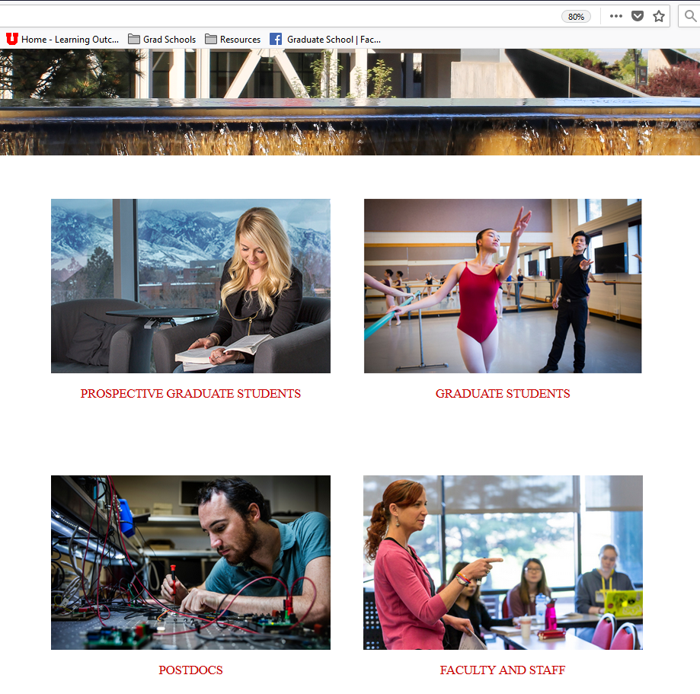
Graduate School Resources

Slide 3
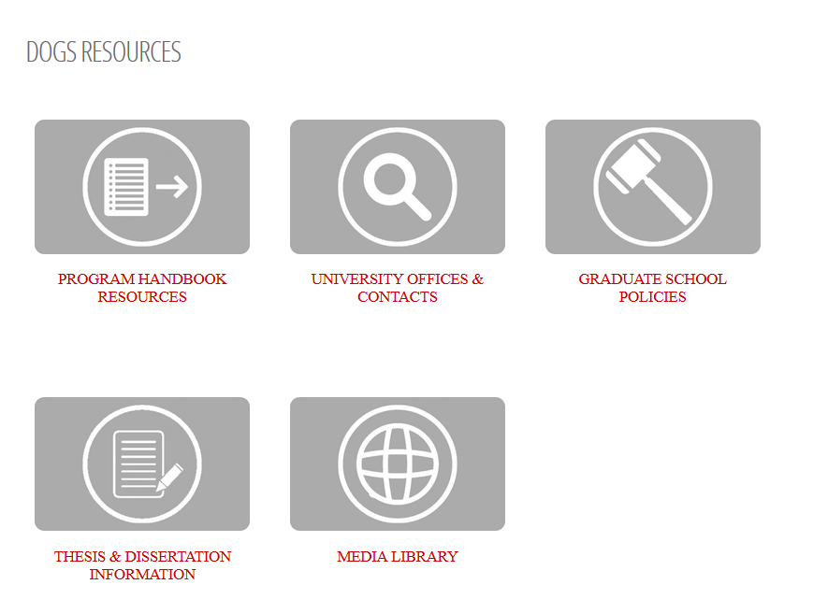
Graduate School Resources
Notes:
University resources – will hear from later today. Importance of interspersing information on mental health.

Slide 4
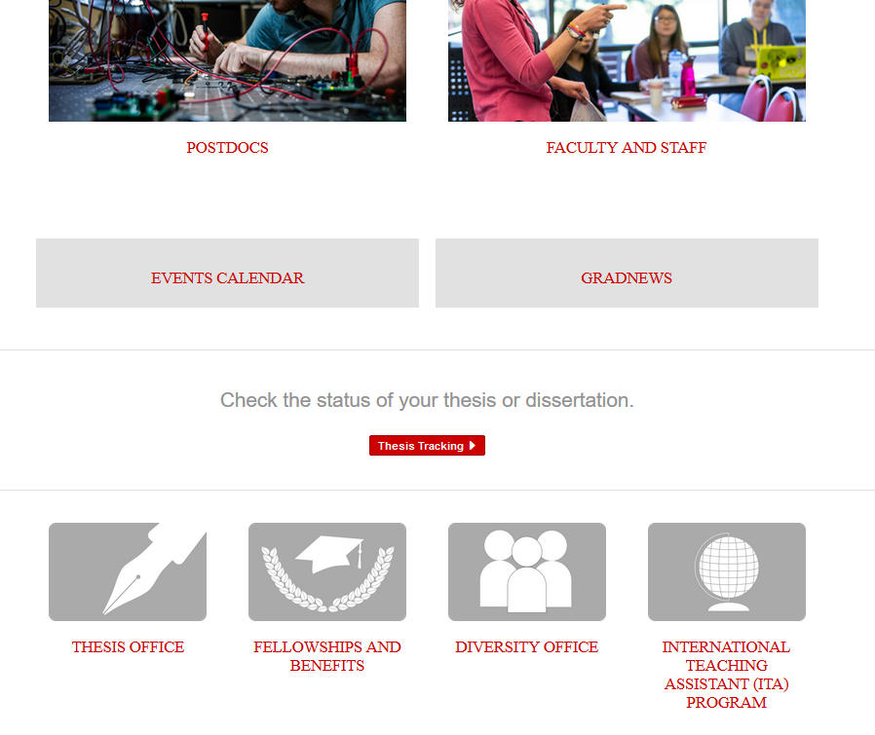
Graduate School Resources

Slide 5
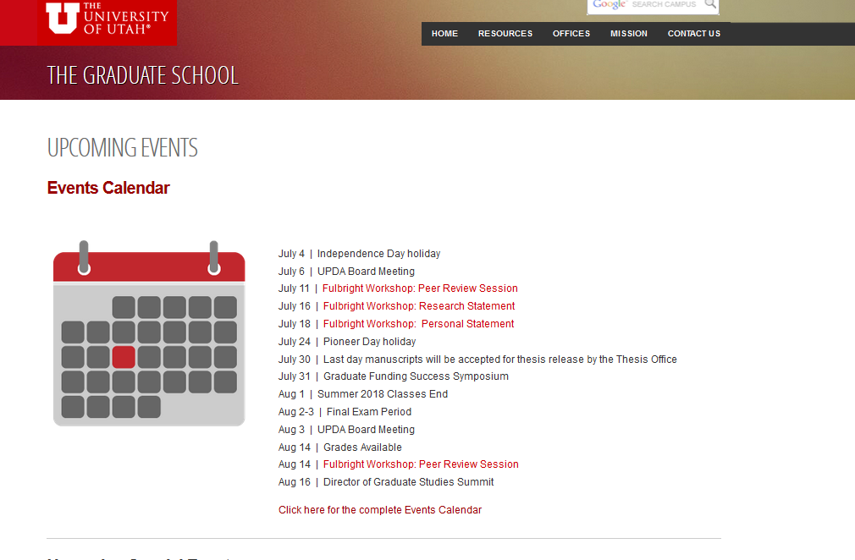
Graduate School Resources

Slide 6
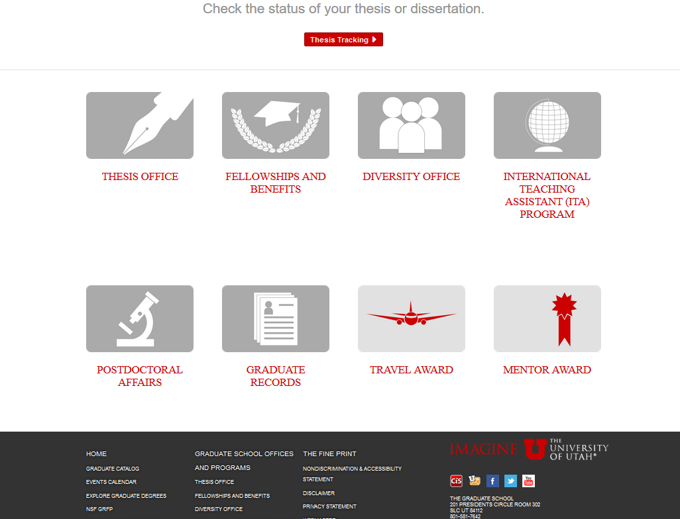
Graduate School Resources

Slide 7
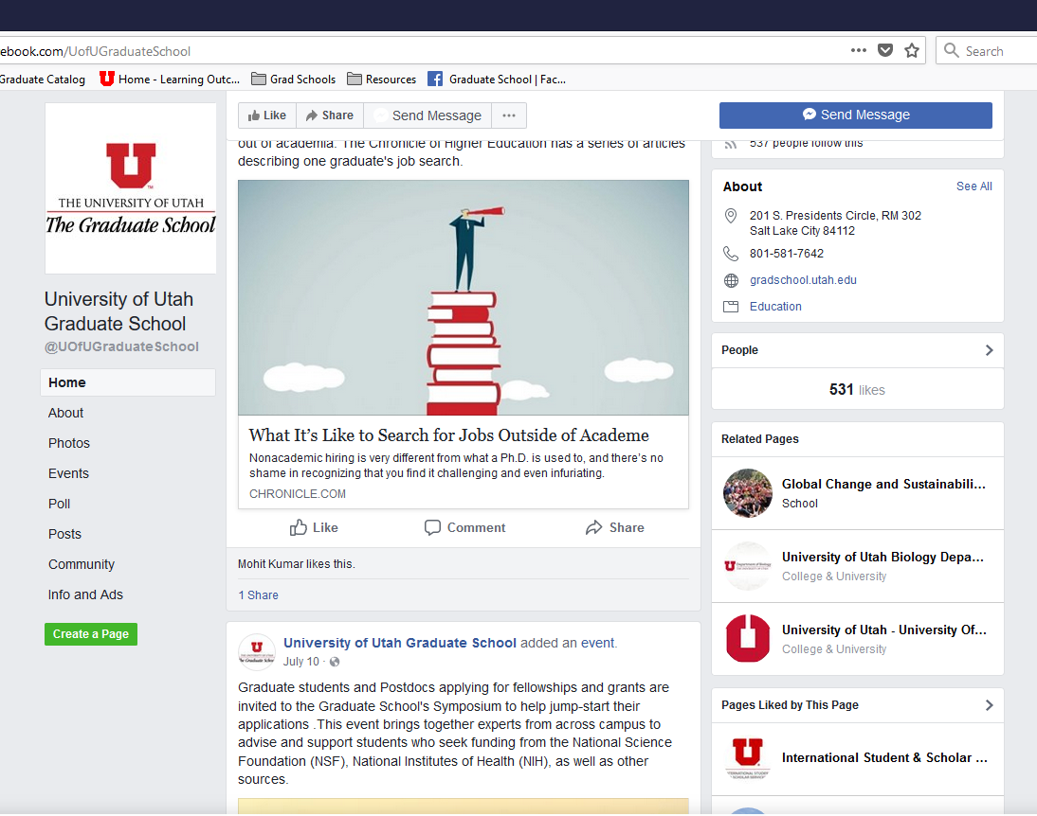
Graduate School Resources

Slide 8
Graduate School Goal
Serve as hub for information about resources
available to UU Grad Students
Info on and links to campus resources, workshops
and events of general interest
You can help us keep informed about info to circulate
and needs that can be met centrally

Slide 9

Upcoming Event

Slide 10



More upcoming events

