Slide 1


Rick Solis (GRADUATE School office retreat 2019)

Slide 2
Topics on todays agenda:
Office Administration
WRGP
GSTAA

Slide 3


Slide 4

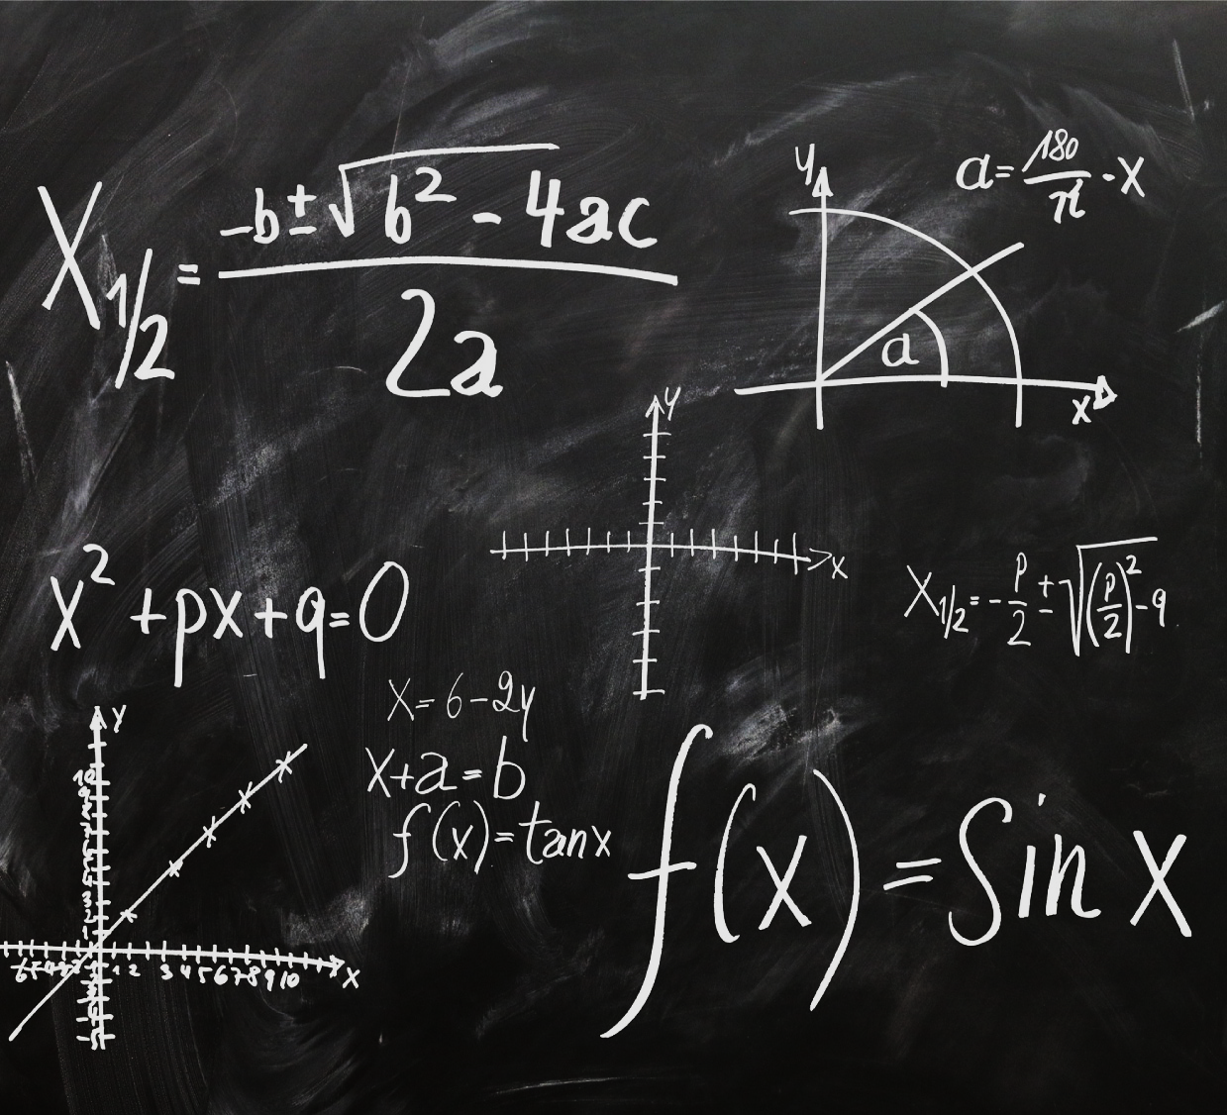




Title for the picture
Include your thesis or major claim regarding the event in history you are discussing.
Find a picture that captures the historical event you are discussing and provides a visual for your audience.

Slide 5
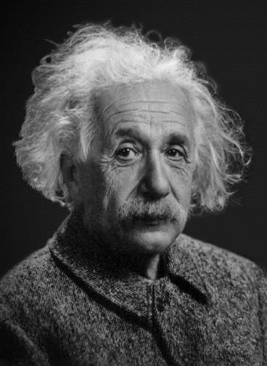
“Three rules of work: Out of clutter find simplicity; From discord find harmony; In the middle of difficulty lies opportunity.”
Albert Einstein

Slide 6
WRGP

Slide 7
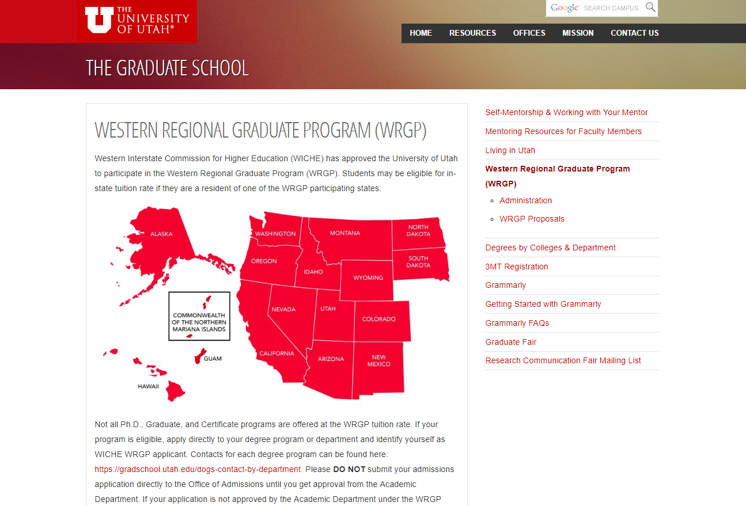

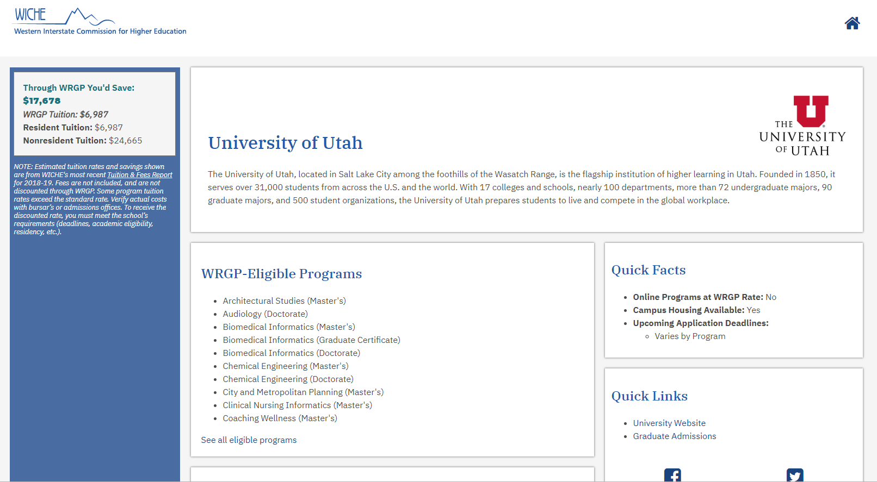
Western Regional Graduate Program
° Appointed Coordinator for the Graduate Schools WRGP program at the U of U.
° Creation of the WICHE WRGP website
° Creation of the website for the Graduate Schools WRGP Graduate students at the UofU
° Prospective student support
° Staff and Faculty support
° Updates to the Graduate Schools WRGP website
Special thanks to Danny and Jason!

Slide 8
Travel

Slide 9

GSTAA
Graduate Student travel assistance award

Slide 10

GSTAA Waitlist History
Data:
[FY15]
Waitlisted
[FY16]
Waitlisted
[FY17]
Waitlisted
[FY18]
Waitlisted
[FY19]
Waitlisted
182
133
159
60
23

Slide 12
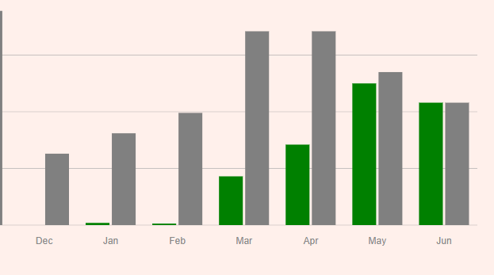
funding status:

Slide 13

Conclusion
By limiting the number of awards a student can receive during their academic career we reduced the amount of students waitlisted.
Every graduate student is guaranteed to receive an award during their academic career.
Future goals:
To be able to award student 2 awards during their academic career at the U of U.
1- award to attend a conference “does not need to present in order to receive funding”.
1- award to attend a conference "presenting requirements to receive funding”

Slide 14
END

