Slide 1
National Science Foundation
Graduate Research Fellowship Program
Personal Statements
  Matthew Plooster, Ed.D.
  Assistant Dean
  The University of Utah Graduate School
  nsf-grfp.utah.edu | www.nsfgrfp.org

Slide 2
What We’ll Cover
NSF-GRFP and eligibility review
Personal statements
    Getting started/statement introduction
    Intellectual merits/broader impacts
    Writing about your experience
    Suggested page structure
    Writing tips
    Common weaknesses
    Drafting your statement
    Proofreading & seeking feedback
FAQs
Resources

Slide 3
What is the NSF-GRFP
The NSF Graduate Research Fellowship Program (GRFP) helps ensure the vitality of the human resource base of science and engineering in the United States and reinforces its diversity. The program recognizes and supports outstanding graduate students in NSF-supported science, technology, engineering, and mathematics disciplines who are pursuing research-based master’s and doctoral degrees at accredited United States institutions.
As the oldest graduate fellowship of its kind, the GRFP has a long history of selecting recipients who achieve high levels of success in their future academic and professional careers. The reputation of the GRFP follows recipients and often helps them become life-long leaders that contribute significantly to both scientific innovation and teaching. Past fellows include numerous Nobel Prize winners, former U.S. Secretary of Energy, Steven Chu, Google founder, Sergey Brin and Freakonomics co-author, Steven Levitt.
- National Science Foundation

Slide 4
Fellowship Benefits
From the National Science Foundation:
Five-year fellowship (3 years of funding, 2 years of reserve)
$37,000/year stipend (X three years)
Tuition coverage (X three years)
Career/life balance (family leave) & access to professional development
From the University of Utah:
Health insurance coverage (X three years)
$2,000/year research expenses (X three years)
Some PIs offer fellowship bonuses

Slide 5
Other Important Benefits
Mobile – you can take it anywhere in the US
Occasionally a step up in graduate admissions
Prestige & recognition
Boosts resume/CV
Establishes a pattern of seeking (and getting) external funding

Slide 6
Eligibility
Must be a US citizen, national, or permanent resident
Enrolled or intend to enroll in a research-based masters or doctorate in an eligible STEM field:
Chemistry | Computer and Information Science/Engineering | Engineering | Geoscience | Life Sciences | Materials Research | Mathematical Sciences | Physics & Astronomy | Psychology | Social Sciences | STEM Education

Slide 7
Eligibility
Who Isn’t Supported
Joint science/professional degree programs (example: JD/PhD)
Business administration or management degrees
Counseling, social work
History (except the history of science)
Education (except STEM education)
Professional degrees (PSM, MPH, MLS, etc.)

Slide 8
Eligibility
Who Isn’t Supported
Research with disease-related goals (unless biomedical engineering)
Clinical research:
    Patient-oriented research
    Epidemiological and medical behavioral studies
    Outcomes research
    Health services research
Pharmacologic, non-pharmacologic, behavioral interventions & studies

Slide 9
Application Components
Transcripts – required from all degree-granting institutions you’ve attended
Statements – Personal Statement and Graduate Research Plan Statement
Reference Letters – two letters are required, but recommended to submit three

Slide 10
Personal Statement
“Personal, Relevant Background, and Future Goals Statement”
Maximum of 3 pages
Must address broader impacts and intellectual merit, each with their own unique header
Your opportunity to talk about who you are, how you’ve prepared for grad school and research, and your professional/leadership goals post-doctorate

Slide 11
Getting Started
Begin by reflecting on your story – consider the following questions:
What’s unique, distinctive, and/or impressive about your story?
What details about you would help set you apart from others that you feel are important for reviewers to know?
How did you become interested in your field? Is there a personal anecdote you can share? And what have you learned about yourself in the process?
What have you learned about the field through classes, readings, seminars, and other work experiences? What initiative did you take?
How have you capitalized on opportunities available to you?
What reasons can you give for reviewers to be interested in you?

Slide 12
Statement Introduction
Start your personal statement talking about you –
Remember: the NSF graduate fellowship funds you as an individual, a scholar, and burgeoning leader
Consider including the following:
Why you are pursuing a graduate degree
Why you are studying science and your specific field
What you are most passionate about with science
Share an outstanding research experience
Challenges you’ve overcome

Slide 13
Statement Introduction
Start with a hook – here are some suggestions:
A story of what sparked your interest in science
A unique research experience – perhaps a lightbulb moment
Your research interests and why they’re personally important to you
A unique leadership or outreach experience relating to STEM
A dimension of STEM you’re passionate about
Your broader impacts in the community
An unexpected twist that led you to where you are today

Slide 14
Intellectual Merits/Broader Impacts
 | You (Personal Statement) | Your Work (Research Plan)
Intellectual Merit | Your merit: describe your motivation, ability, research experiences, preparation, achievements, perseverance, and your future goals (scholarly, professionally) | Merit of your work: describe your topic, innovation, rigor, creativity, new knowledge your research will create, and contributions to existing science
Broader Impacts | Your impact: describe your background, personal story, broadening participation, outreach, identity, initiative, leadership, communicating science | Impact of your work: describe the foundational nature, relevance, importance to society, and any educational or interdisciplinary connections of your research

Slide 15
Intellectual Merits
This is you describing your potential to advance knowledge through research and scholarly activities:
Your history and preparation as a student, scholar, and leader
Documented intellectual ability (GPA, awards, etc.)
Evidence of your ability to:
    Plan and conduct research
    Work independently
    Communicate research
    Take initiative, solve problems, persist

Slide 16
Broader Impacts
This is where you describe your impact on society, personally and through research.
Describe how you have impacted your community:
Participation with and impact on diverse populations
Outreach, teaching, mentoring, and impacting STEM education in schools and community
Community outreach: participation in and leadership of science clubs, writing/blogging/podcasts, other media
Impact in creating and cultivating a diverse workforce
Increase collaboration between academic and industry sectors

Slide 17
Writing About Experience
Describe the sort of projects you worked on:
Who was your research advisor/faculty mentor/PI?
How did you get involved?
What was your role? Were you independent or part of a team?
What sort of skills and knowledge was gained from the experience?
What were the results (publications, presentations, recognition, etc.)?

Slide 18
Suggested Page Structure
Consider including the following elements in your narrative:
Your relevant background – your past, your foundation
Your present – where you are today (undergrad, grad school) – how you have prepared for graduate education and to be a scholar and leader
Your future – what you hope the next 20-30(ish) years will look like for you – what you hope to achieve in your career, the paths down which you hope to grow as a scholar, professional, and leader

Slide 19
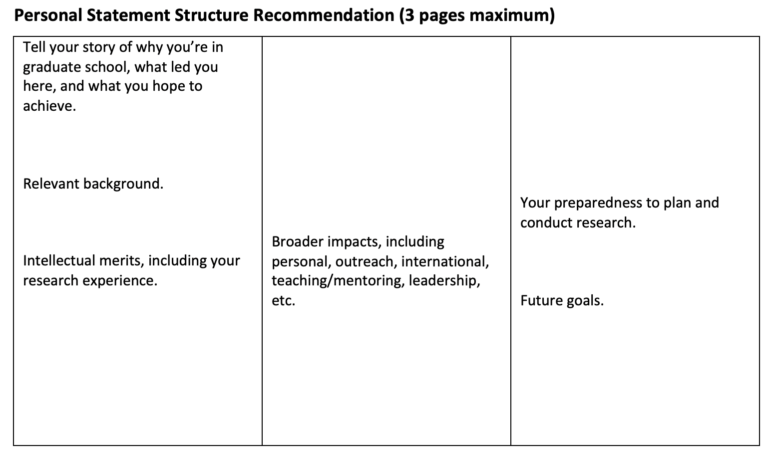
Suggested Page Structure

Slide 20
Writing Tips
Write clearly – allow your voice to flow clearly:
Be pithy and succinct – only include what is necessary
Omit unnecessary language, especially technical jargon
Use shorter words over longer, more complicated vocabulary
Make sure each sentence is purposeful

Slide 21
Writing Tips
Know your audience:
Keep in mind who your reviewers will be – busy faculty!
Know what your audience is looking for – easy, digestible information
Write in a way that makes it easy for readers to get the most important info they need to in order to make a decision

Slide 22
Writing Tips
Be confident in yourself:
Remember: the NSF is funding you, not your PI or research team
Take ownership of your scholarly experiences and achievements
Be honest about your career goals
Don’t understate or undervalue your accomplishments
Highlight your role in your projects, research, and leadership roles
Write with “I” statements, as opposed to “we” statements
Tell your compelling story

Slide 23
Important Considerations
NSF-GRFP outreach goals – to attract a diverse and qualified applicant pool – with particular attention to:
Students attending Minority Serving Institutions (MSIs)
Students studying in EPSCoR jurisdictions
Non-traditional education tracks

Slide 24
Non-Traditional Students
Non-traditional students – you are encouraged to apply!
In your narrative, discuss the “why” behind returning to school
Why are you going back to school now?
Why are you pursuing graduate education, and why this area of study and research?
What has been your motivation to take this step?

Slide 25
Common Weaknesses
Unorganized personal statements that don’t tell a clear story
Personal statements that are unclear, incomplete, or unpolished:
    Failure to “own” your research and experiences
    Unclear future goals
    Vague descriptions of experiences
Dense writing that is difficult to understand or is uninteresting
Too much jargon
Failure to address your broader impacts

Slide 26
Drafting Your Statement
Just get started! Here are some suggestions:
Begin with an outline – map out your past, present, and future
Write a first draft – don’t worry about length, structure, idea formation – get something on paper to start with
Plan for many drafts of your personal statement!
Proofread before taking to others to review
Don’t leave spelling and grammar checks to the software – they’re not always accurate!

Slide 27
Proofreading & Seeking Feedback
Identify multiple proofreading partners – faculty, fellowship advisor, classmates, friend/family, Writing Center consultants, etc. – you want a variety of individuals from varying backgrounds
Ask for feedback on how your narrative flows and how ideas are articulated – readers should walk away with a decent understanding of what you’re trying to say, even if they aren’t familiar with the technical components
Don’t let spelling and grammar checks be your primary focus of feedback and review
Plan to go through several rounds of proofreading and editing

Slide 28
Frequently Asked Questions
Q: The personal statement limit is three pages – does this include sources or can I have another page for a bibliography?
A: The three-page limit is a maximum in total – you cannot exceed three pages to add a bibliography, appendix, etc.
Your final submission cannot, under any circumstance, exceed three pages in the prescribed formatting.

Slide 29
Frequently Asked Questions
Q: Can I use an image?
A: Yes! Images are allowed and, in some cases, encouraged.
When using equations in your statements, the NSF recommends using an image rather than typing out the equation in your text.
Caution: while images are allowed, remember that they do take up valuable space! Ensure that the image is necessary and purposeful.

Slide 30
Frequently Asked Questions
Q: How many drafts of my personal statement should I plan to go through?
A: This varies, but many successful applicants will go through 10-20 rounds of proofreading and editing.
Advice: there is always the ability to continue “perfecting” our writing, but there is a point where you say it’s good enough for the purpose of the application.

Slide 31
Frequently Asked Questions
Q: A few of my proofreading partners aren’t scientists or professors, should I take their advice on how I talk about my research?
A: Yes! Non-STEM reviewers provide a valuable non-specialist perspective that will help shape your narrative.
Non-STEM proofreaders should be able to walk away with a decent idea of what you’re trying to accomplish; if they don’t, you will want to address.
If a non-STEM reviewer says that a concept isn’t well-defined or they couldn’t understand a dense explanation, take that feedback seriously.

Slide 32
Resources
Annual solicitation (nsfgrfp.org) – 2024 solicitation will be posted late July/early August
Previous workshops, tools, & resources found online (nsf-grfp.utah.edu)
Your faculty mentor / research PI
The University of Utah Writing Center (writingcenter.utah.edu)
Graduate fellowship advising (fellowships@gradschool.utah.edu)

Slide 33
Questions?
Matthew Plooster, Ed.D.
Assistant Dean
The University of Utah Graduate School
For NSF-GRFP application resources & trainings, visit www.nsf-grfp.utah.edu
For NSF-GRFP application portal and solicitation, visit www.nsfgrfp.org
For questions or to schedule advising appointments, email fellowships@gradschool.utah.edu

